Slide 1
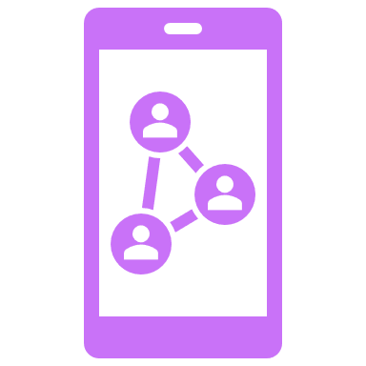
Social Media Accessibility Basics
Mark McCarthy, MSIM, IADP, CPWA
For CARLI Professional Development Alliance, 10/27/22

Slide 2
Agenda
What defines disability?
Disability 101
WCAG Explained in 150 Words or Less
Why Social Media Accessibility Matters
Accommodation statements
Live example (time permitting)
Summary
Wrap-up/Q&A

Slide 3
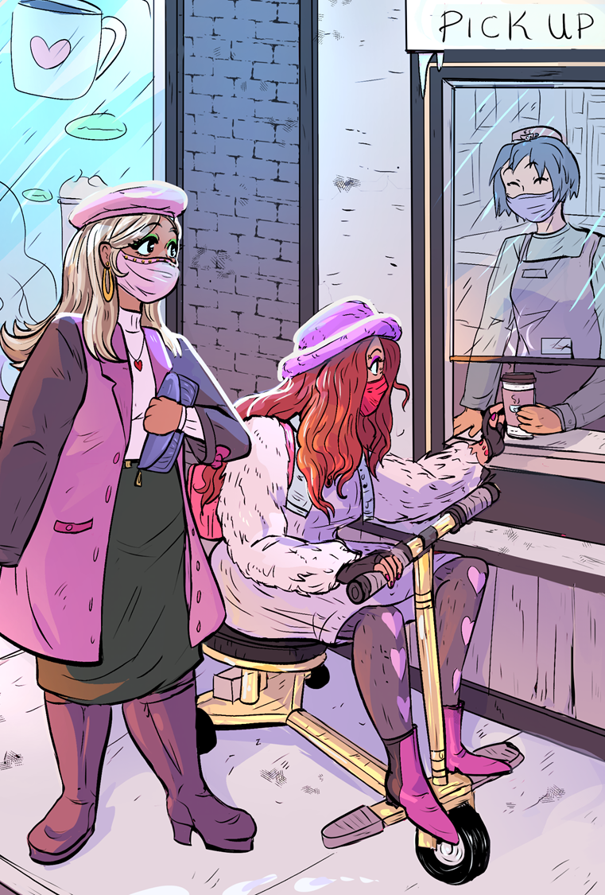
Disability?
The ADA defines a person with a disability as a “person who has a physical or mental impairment that substantially limits one or more major life activity. The ADA also makes it unlawful to discriminate against a person based on that person’s association with a person with a disability.”
Likely more people than you think live with disabilities!
The WHO estimates about 15% of the world’s population – 1 BILLION people – live with a disability.
That’s more than the entire population of Europe, and only a little less than all of China!
The CDC estimates about 26% of Americans – 1 in 4 – live with disability.
This number will only increase as we better understand and learn about COVID.
There are various reasons this may not be accurate.
Disabled folks are the worlds’ majority minority.
It’s not a bad word!
Illustration: Dominique Davis for Disabled And Here.

Slide 4
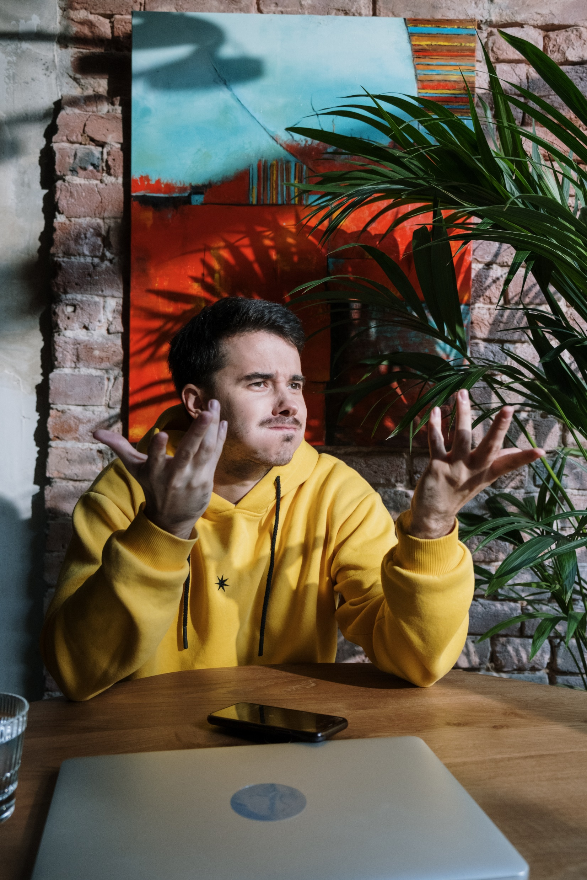
Assistive Technology and Creativity
There are several ways that disabled folks use tech, some more creative than others!
Folks that are blind, have poor vision, or sometimes cognitive disabilities might use a screen reader or narration software to access their computer. Audio description also helps.
People who are D/deaf, hard-of-hearing, or have other auditory issues primarily benefit from captions, subtitles, and transcripts. Some may also like to use haptic vests (vests with vibrating speakers) depending on their needs.
Those with limited mobility (like me!) may use speech-to-text software to dictate or access applications, may only use a keyboard, and/or may use a mouthstick or other devices for the mouth or head to access their computer.
Many things that are now common items started as assistive tech, such as the Oculus (Meta) VR headset; dictation software; curbcuts; auto-captions; audio/e-books; what can you think of that has such a dual purpose?
Notes:
May not be accurate due to trust in medical systems; stigma in different socioeconomic groups or communities; lack of medical support or diagnosing techniques

Slide 5
Major life activities?
Major life activities, or activities of daily living, can include things like, but are not limited to:
Self-care
Eating
Hearing
Seeing
Walking
Speaking
Thinking
h/t Lindsay Haitz
Photo via The CP Lawyer, 2021

Slide 6
Sounds like when I broke my arm…
Right! Many disabilities can be permanent, temporary, or even situational! While accessibility and accommodations may be necessary for some folks, it can benefit everyone!
This concept of permanent, temporary, and situational leans heavily on the social model of disability.
In simple terms, it is not a condition that limits someone, it is a societal barrier causing the disabling effect.
In other words, this means that the way society is physically built and metaphorically/socially structured has a disabling effect.

Slide 7
Person-First Language
Person with a disability
Individual with _____ (e.g., epilepsy, psychiatric disability, intellectual disability, mental illness, etc.)
Person who is ____ (e.g., deaf, blind, hard of hearing)
Individual who uses a ____ (e.g., wheelchair, cane, walker)
Person who has _____ (e.g., depression, anxiety, ADHD)

Slide 8
Identity-First Language
Some individuals prefer Identity-First language:
Disabled Person
Deaf Person (Big D refers to Deaf culture, little d refers to medical condition of deafness)
Autistic Person
There are more!
Some things to think about…
There will always be exceptions,
Ask if you are in a position to ask, (“May I ask how you’d like to be referred to as?”)
When referring to a broad community use default language most commonly used by members of the community (not parents or allies)*, and
Pay attention to how the person you’re interacting with refers to themselves.
This is a lot like, and intersects with, interacting with queer folx!
*Many disabled people tend to default to “disabled people” for the group, myself included.

Slide 9
Accessibility vs. accommodation
INACCESSIBLE
ACCOMMODATION
ACCESSIBLE
EQUALITY
Everyone receives the same support, regardless of need.
EQUITY
Individuals given different support / accommodation to enable access.
INCLUSION
Everyone has access: No need for support / accommodation

Slide 10
WCAG (or, Web Content Accessibility Guidelines)
Web Content Accessibility Guidelines (WCAG) is developed in cooperation with individuals and organizations around the world, with a goal of providing a single shared standard for web content accessibility that meets the needs of individuals, organizations, and governments internationally. – W3C-WAI

Slide 11
WCAG for the Uninitiated (in 150 words or less)
WCAG 2.0 and WCAG 2.1 are stable, referenceable technical standards. They have 12-13 guidelines that are organized under 4 principles: perceivable, operable, understandable, and robust. For each guideline, there are testable success criteria, which are at three levels: A, AA, and AAA.
It is primarily intended for:
Web content developers (page authors, site designers, etc.),
Web authoring tool developers,
Web accessibility evaluation tool developers, and
Others who want or need a standard for web accessibility, including for mobile accessibility.
Important to note: WCAG is a technical standard, not an introduction to accessibility. BUT! WAI provides personas and quick testing guides to help you along your journey, as well as a “Where should I start?” guide in the FAQ.
WCAG 2.1 is the current standard, though many federal and state laws have not yet caught up to it. However, WCAG 2.1 is perfectly backwards compatible with WCAG 2.0, and is a good target to meet.
Note: Only level A and AA criteria are required to be met by law; AAA are typically more difficult to implement or cause conflicting access. If you can achieve some, many, or all AAA requirements for your use case, go for it! But is not required.

Slide 12
Why Social Media Accessibility Matters

Slide 13
Subtitles, Captioning, and Alt Text
About 85% of Facebook video, and most digital media, is watched on mute. In 2022, about 82% of all internet traffic will be video. (Patel, Cisco)
Many studies and reports conclude a vast majority of people – more than the total of D/deaf/Hard-of-Hearing folks – use subtitles and captions. (Ofcom)
Several studies show subtitles aid comprehension, retention, language acquisition, and focus. (TotS)
More people watch entire videos or other media when captions are available. (Verizon via McCue)
As more people consume media on the move, in noisy (or quiet) places, and on smaller screens, captions become more important.
Reach, SEO, and engagement numbers explode with proper captioning and alt text. (Really! Google ranks accessible content higher in search results and indexes!)

Slide 14
Subtitles and Captioning, 2
Online, there’s also “a meme culture that means, if you’re quick enough to put a funny screengrab online complete with caption, you could be looking at likes and retweets well into five figures. “…even programme-makers have dabbled…Netflix’s official Twitter account for its show Sex Education is called ‘no context sex education’ and just features grabs from the show.” (Davies)
Users today are more receptive than ever to brands, corporations, entities, and creators they enjoy making sure their digital media is appropriately accessible and inclusive.

Slide 15
Subtitles and Captioning, 3
Captioning accuracy depends on the need and context!
Autocaptioning ranges from 75-90% accurate (despite marketing).
Depends on MANY factors. Despite marketing.
Captioning for live events is often meaning-for-meaning, rather than word-for-word, which may be less than 100% accurate.
Captioning for completed, published media, should be >99% accurate.
That accuracy matters! 🎯
90% accurate is about 1 error/sentence; 10 errors/paragraph.
99% accurate is about 1 error/paragraph. (Knight)

Slide 16
Community and Socializing (SOCIAL Media)
Many disabled people – even prior to COVID isolation – often face more barriers* to social settings and in turn find community online. Ensuring online media is inclusive creates better spaces for everyone inhabiting them.
*1 or 2 steps into “wheelchair accessible” spaces; lack of sober venues; many social spots are loud and/or dark; etc.
COVID has exacerbated the isolation many disabled folx already faced, and “innovative” solutions (broad online/remote work, digital concerts, YouTube live meetups, etc. etc. etc.) suddenly happened in large part due to abled folx experiencing only a small part of that for the first time.

Slide 17
Community and Socializing, 2
There is not a wealth of citation for this phenomenon, and you may be able to start guessing why.
This is not a moment to shame what hasn’t been done or pity anyone, but a call to keep that momentum of accessibility and inclusivity around experiences, opportunity, and community alive and fervent.
For what might seem like the first time, disabled content creators have leveraged an enormous platform in TikTok to build a genuine audience like never before. Influencers with a range of disabilities have tapped into a young, eager audience.
Now, these disabled creators are using the app to tell their stories in their own words, without being forced into the conventional narratives of disability -- all while introducing a new generation to a different kind of star. They’re fighting for representation in a media landscape that has otherwise ignored them.
- Muldofsky, et al

Slide 18
Platform Specific Tips (non-exhaustive)
Platforms covered include Facebook, Instagram, YouTube, and TikTok
Most platforms publish specific help documents

Slide 19
Facebook
Note: Tips presented here will apply to many platforms, contexts, and situations.

Slide 20
Facebook Best Practices
Facebook is likely one of the most flexible platforms.
Allows for alt-text on images.
Allows for uploading your own captions (SRT files please!) for videos.
Allows for huge flexibility of OS-based accessibility features.
Things like text resizing, color adjustment, speech input, screen readers, etc.
Can include a wealth of useful information!
To write good alt-text, think about:
How would you describe this over the phone to someone?
What details are so important you had to call about them and describe them?
How would you give them the whole context so they could get the whole picture and think about it, rather than just what you think is important, or what you think they think is important?

Slide 21
Facebook Best Practices, 2
When posting about an event, include as much useful information as you can. Some, like date, time, location, may be redundantly described from your alt text if that info was in a photo. Think of the following things:
What time is it? Where is it? How can you get there? Which side (cardinal or landmark) is the main entrance/reception on?
Is there a nearby bus stop? How long would/should an Uber/Lyft/taxi take? Is there a hotel shuttle?
Are there accessible bathrooms? Is there a spot to take a service animal to the bathroom? Is it scent free? Do content warnings apply?
Will there be live captioning? CART? SL interpreters?
If someone needs help with anything, more details, etc., specifically who can they contact, and specifically how? Ensure the contact person knows they may be asked for help.
Try to include both email and phone access!
Specifically – meaning a generic phone number or catchall mailbox. Instead, “Contact Gillian_Anderson@institution.org or 999-555-0123 for assistance or questions.” More on this later.
You don’t have to drone on and on with any of this, but including it near the end of the post, or following up a comment with this info, is great!
Consider using something like Cornell’s Accessible Meetings Guide or SIGACCESS’ Accessible Conference Guide. Specifics may not apply, but they should jump start a conversation!

Slide 22
Quick Facebook How-tos
To add captions to a video:
Click Photo/Video at the top of your timeline or News Feed.
Choose a video from your computer, then click Post.
Facebook will send a notification once the video is ready. Click the notification or the gray date and time at the top of the post on the News Feed or timeline.
Click More in the top right and select Edit video.
Click “Choose File” below “Upload SRT files” and select a .srt file from your computer.
Click Save.
To add alt-text to photos:
Click Photo/Video at the top of your News Feed.
Select the photo you want to add, and select “Edit” (with a pencil icon).
The automatically generated text will be shown on the left side of your photo. Click Override generated alt text to edit it.
Write your alt text in the box. To change back to the automatically generated text, click Clear.
Click Save once you are done.
To change the alt text of a photo after you've posted it:
Click the photo to open it.
Select the menu dots in the top right and select Change Alt Text.
Click Override generated alt text or change the alt text in the text box. You can also click Clear to change your edited alt text back to the automatically generated text.
Click Save once you are done.
To read more or revisit this, visit Facebook’s Accessibility Center.

Slide 23
Facebook Warnings
Facebook will automatically generate alt text, but it is often poor quality and may not properly represent a photo (computers aren’t very smart).
Similarly, don’t rely on autocaptions generated by Facebook – they are likely to have so many mistakes so as to be unusable (affectionately called “craptions”).

Slide 24
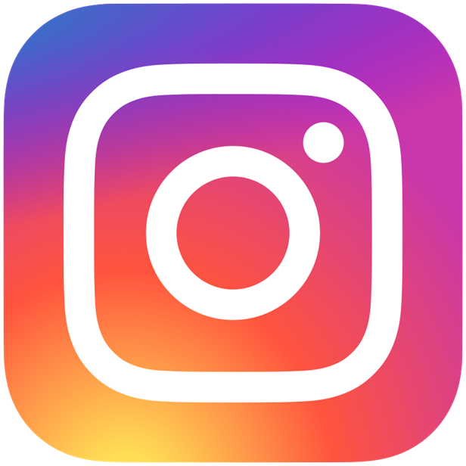
Instagram

Slide 25
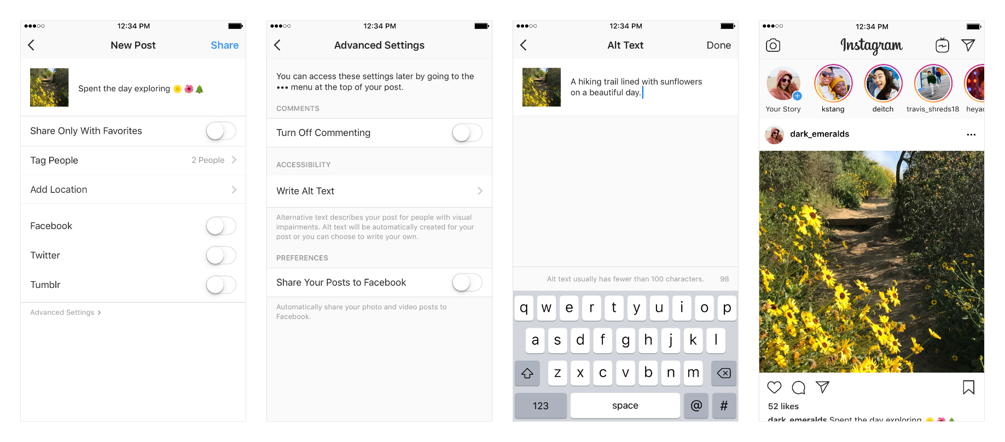
Instagram Best Practices
As Instagram is focused on photos, you’ll really be flexing your alt-text skills! You’ll find these options under the “Advanced Settings” button on your new post.

Slide 26
Instagram Best Practices
When writing your alt text, think about:
What is in your photo that you want someone to see?
Why is that photo important, especially in relation to your text caption?
Is there anything included in your photo, relevant to its context, that is NOT in your caption?
Instagram is more limited and visual in many ways, so think carefully!
! Consider linking someone to a more usable listing – like a Facebook event post, a Tweet, or providing a Google doc etc. – if you have lots of information to convey.
To revisit the required steps, see Instagram’s Alt-text Help.

Slide 27
YouTube

Slide 28
YouTube Best Practices
Think of the “YouTube” section more as a “video” section. Some specific considerations to be aware of:
Your videos need to be properly captioned. This does not include autocaptioning (its accuracy is not acceptable). However, autocaptioning is a good place to start.
Your videos need to have an audio description. Some examples of this include a trailer for Frozen, Harry Potter 7, video game trailers, and many current movies and shows on Netflix.
Note: YouTube currently does not allow for videos with multiple audio tracks. Many orgs and creators that do AD often upload both a version with and without it, labelling the AD version with [AD] or #AudioDescription in the title. The need for this may vary.
Captioning is provided for any live event.
More specifics for each of the above are in WCAG by following the Understanding [Success Criteria name] links.
These considerations generally do not apply IF the audio/video is an alternative for text-based media AND it is clearly marked as such to a user.

Slide 29
More on Video
Be aware that the party responsible for providing the previous accommodations is the “host”/provider/entity providing the content, NOT the user/attendee or the software used to provide an event (Zoom, etc.) For example, an attendee may request captioning for an event - the host is responsible for sourcing and paying for such services.
If these kinds of services are completely out of the question (budgets etc.), try to work with the attendee to come up with a good solution, rather than shutting them out – and try to be kind and understanding.
Work smarter, not harder. While autocaptioning or machine-learning captioning services (Otter.ai, Descript, Kaltura, YouTube etc.) are not sufficient for something presentable, they are a good place to start making a transcript, if a script was not previously written. After an auto-transcript is created, you can go through it for punctuation, spelling, and timing!
Be aware that you will also want to pay attention to contrast of words or important details in the video, flashing (no more than 3/sec), vertigo/parallax effects, content warnings, and/or user environments (low bandwidth areas, outside in the sun, etc.).

Slide 30
Captioning or Adding Captions to a YouTube Video
To create captions:
Sign in to YouTube Studio.
From the left menu, select Subtitles.
Click the video that you'd like to edit.
Click ADD LANGUAGE and select your language.
Under subtitles, click ADD.
To upload captions:
Before you start, make sure that your file type is supported on YouTube. (There are many, but SRT is a good place to start.)
Select Upload file.
Choose between With timing or Without timing, then select Continue.
Choose a file to upload.
Select Save.
Other features and instructions can be found on Google’s Captioning Help page.

Slide 31
TikTok

Slide 32
TikTok Best Practices
New kid on the block! TikTok is wildly popular, and lots of “non-traditional” users also use it to great success e.g., libraries, waste management and recycling, trucking industry, urban planning – to name a few of my own non-trad followings.
Video best practices apply!
Be careful, or properly warn viewers of flashing.
Make sure you have captioning enabled for your videos.
If something important is ONLY visually represented, make sure to audibly describe it too.
Use the text-to-speech option if you are posting something with text overlays only.

Slide 33
Captioning TikToks
To caption a TikTok:
Record or upload a TikTok video
Turn on the auto- caption feature
Edit Captions

Slide 34
On Accommodation Statements
It is good practice to include them in places where documents may be accessed, or on the bottom of flyers, etc.
If you require any accommodations to more fully participate in this event, please email Gillian_Anderson@instituion.org.
For questions about accessibility or to request accommodations please contact Gillian Anderson at gands@insitution.org or 999-555-0123.
All participants are welcome. If you need disability-related accommodations, please call Gillian at 999-555-0123.
May not just be related to disabilities!
Ensure the person set up for contact knows they may be contacted and what to do if so.

Slide 35
In Summary
Add – and correct – captions where appropriate;
Add alternative text where appropriate. Ensure it makes sense in context;
Ensure your events have adequate accommodations in place, and if not;
Ensure someone specific is tasked with helping to facilitate accommodations;
Be open to making mistakes and improvements. This is always a learning process!

Slide 36
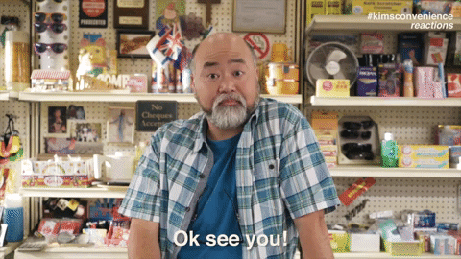
Call me beep me!
Mark McCarthy
Lead Accessibility Engineer, QA
Administrative Information Technology Services
University of Illinois System Office
217-300-3408 | mcmccar2@uillinois.edu
Want more?
Crutches and Spice, a blog by Imani Barbarin, disability advocate and comms expert;
Andrew Gurza, an award winning 🌈x♿ speaker and advocate.
Rikki Poynter, content creator, writer, accessibility consultant, and public speaker. Specializing in variety of disability (deafness, chronic pain, fatigue) related topics.
Want to be certified in some accessibility basics (or advanced…s)?
Look into UIUC’s IADP program (I’m an instructor!) or IAAP’s various offerings!

Slide 37
References
Accessibility NYC. (2019, March 5). Why human captioning? - Mirabai Knight. YouTube. https://www.youtube.com/watch?v=OYzLPqKIJFw (Updated May 2022)
“Cisco Annual Internet Report.” Cisco, 1 Dec. 2020, www.cisco.com/c/en/us/solutions/executive-perspectives/annual-internet-report/index.html.
Davies, Hannah J. “Lights, Camera, Caption! Why Subtitles Are No Longer Just for the Hard of Hearing.” The Guardian. Guardian News and Media, July 21, 2019. https://www.theguardian.com/tv-and-radio/2019/jul/21/subtitles-tv-hearing-no-context-twitter-captions.
Erickson, W. Lee, C., & von Schrader, S. (2021). 2018 Disability Status Report: United States. Ithaca, NY: Cornell University Yang Tan Institute on Employment and Disability (YTI).
McCue, TJ. “Verizon Media Says 69 Percent of Consumers Watching Video with Sound Off.” Forbes. Forbes Magazine, July 31, 2019. https://www.forbes.com/sites/tjmccue/2019/07/31/verizon-media-says-69-percent-of-consumers-watching-video-with-sound-off.
Muldofsky, Mack, Lauren Dimundo, and Allie Yang. “Disabled Creators on TikTok Show the World It’s Time for a Different Kind of Star.” ABC news. ABC News Network, April 29, 2021. https://abcnews.go.com/US/disabled-creators-tiktok-show-world-time-kind-star/story?id=77402363.
Patel, Sahil. “85 Percent of Facebook Video Is Watched without Sound.” Digiday, May 9, 2019. https://digiday.com/media/silent-world-facebook-video/.
“Research into Same-Language Subtitling.” Turn On The Subtitles, February 24, 2021. https://turnonthesubtitles.org/research/.
Television access services, Review of the Code and guidance, March 2006. https://www.ofcom.org.uk/__data/assets/pdf_file/0016/42442/access.pdf.

